Slide 1
A Sample of Use Cases Built in Power BI

Slide 2
List of Use Cases:
1 | حركة الطيران الجوية السنوية في مطارات المملكة
2 | Adidas Sales in US 2020-2021
3 | PWC Calls Center Performance
4 | Incident Management Dashboard

Slide 3
01
حركة الطيران الجوية السنوية في مطارات المملكة

Slide 4
Dashboard Overview:
The dashboard presents key air traffic statistics for Saudi Arabian airports in 2020 and 2021, including passenger traffic, flight operations, and cargo data, all sourced from the open data provided on the GACA website.
Here are some questions a dashboard can answer:
How has air traffic movement (cargo, passengers, and flights) changed in Saudi Arabian airports from 2020 to 2021.
What is the overall trend in air traffic movement in the Kingdom's airports.
How does air traffic movement compare between domestic and international airports.
Which airports had the highest cargo, passenger, and flight movements in 2021.
What was the total cargo movement in Saudi Arabian airports in 2020 and 2021.
How much did cargo movement increase from 2020 to 2021.
How many passengers traveled through Saudi Arabian airports in 2020 and 2021.
How much did passenger traffic increase from 2020 to 2021.
How many flights operated in Saudi Arabian airports in 2020 and 2021.
How much did the number of flights increase from 2020 to 2021.

Slide 5
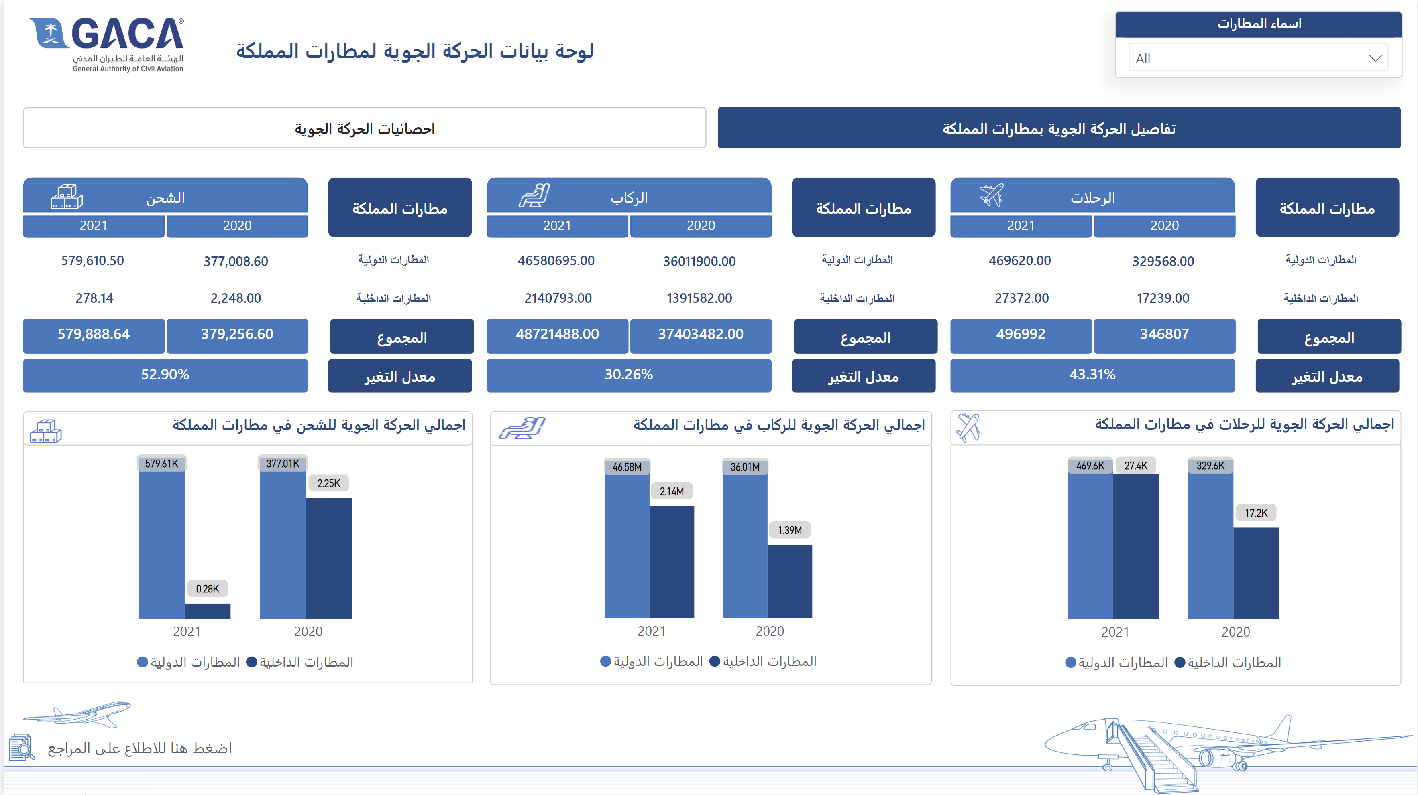
احصائيات الحركة الجوية
Dashboard Screenshot
Click here to interact with the dashboard.
Notes:
image
No alt text provided
textbox
No alt text provided
actionButton
No alt text provided
pageNavigator
No alt text provided
image
No alt text provided
image
No alt text provided
clusteredColumnChart
No alt text provided
اجمالي الحركة الجوية للرحلات في مطارات المملكة
No alt text provided
image
No alt text provided
clusteredColumnChart
No alt text provided
اجمالي الحركة الجوية للركاب في مطارات المملكة
No alt text provided
image
No alt text provided
clusteredColumnChart
No alt text provided
اجمالي الحركة الجوية للشحن في مطارات المملكة
No alt text provided
image
No alt text provided
shape
No alt text provided
image
No alt text provided
card
No alt text provided
card
No alt text provided
shape
No alt text provided
shape
No alt text provided
card
No alt text provided
card
No alt text provided
card
No alt text provided
card
No alt text provided
card
No alt text provided
textbox
No alt text provided
shape
No alt text provided
shape
No alt text provided
shape
No alt text provided
shape
No alt text provided
card
No alt text provided
card
No alt text provided
shape
No alt text provided
shape
No alt text provided
card
No alt text provided
card
No alt text provided
card
No alt text provided
card
No alt text provided
card
No alt text provided
textbox
No alt text provided
shape
No alt text provided
shape
No alt text provided
shape
No alt text provided
shape
No alt text provided
card
No alt text provided
card
No alt text provided
shape
No alt text provided
shape
No alt text provided
card
No alt text provided
card
No alt text provided
card
No alt text provided
card
No alt text provided
card
No alt text provided
textbox
No alt text provided
shape
No alt text provided
shape
No alt text provided
shape
No alt text provided
اسماء المطارات
No alt text provided

Slide 6
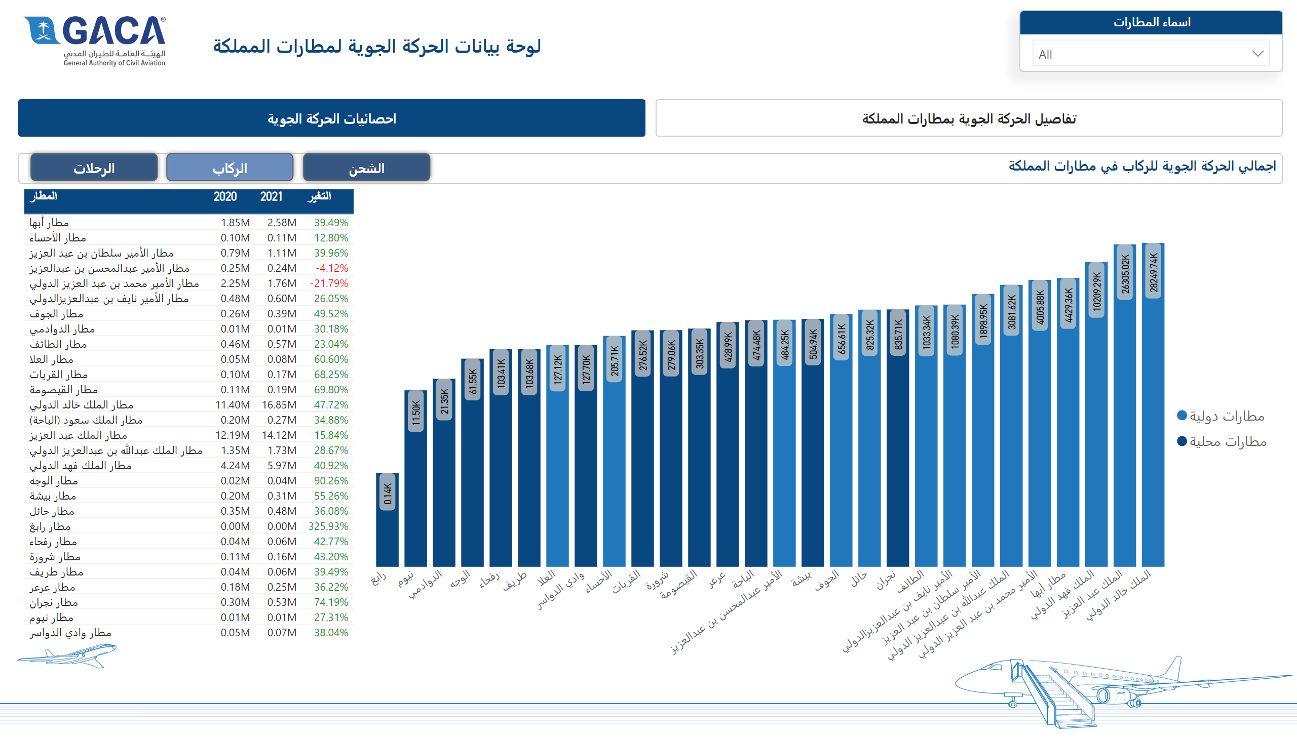
تفاصيل الحركة الجوية بمطارات المملكة
Dashboard Screenshot
Click here to interact with the dashboard.
Notes:
image
No alt text provided
textbox
No alt text provided
pageNavigator
No alt text provided
tableEx
No alt text provided
columnChart
No alt text provided
actionButton
No alt text provided
actionButton
No alt text provided
actionButton
No alt text provided
textbox
No alt text provided
اسماء المطارات
No alt text provided
actionButton
No alt text provided
actionButton
No alt text provided
actionButton
No alt text provided
tableEx
No alt text provided
columnChart
No alt text provided
textbox
No alt text provided
tableEx
No alt text provided
الرحلات
No alt text provided
columnChart
No alt text provided
الركاب
No alt text provided
اجمالي الحركة الجوية للركاب في مطارات المملكة
No alt text provided
الشحن
No alt text provided

Slide 7
02
Adidas Sales in US 2020-2021

Slide 8
Dashboard Overview:
This dashboard contains information about Adidas sales that can be useful for various purposes. For example, analysis of sales trends, identification of successful products or marketing campaigns.
Here are some questions a dashboard can answer:
Number of units sold.
The total sales profit.
Total units Sold.
Total sales per region.
Total sales per product.
The most common methods used to obtain products.
Total sales and profit per year and month.
Top and worst Product Sold.

Slide 9
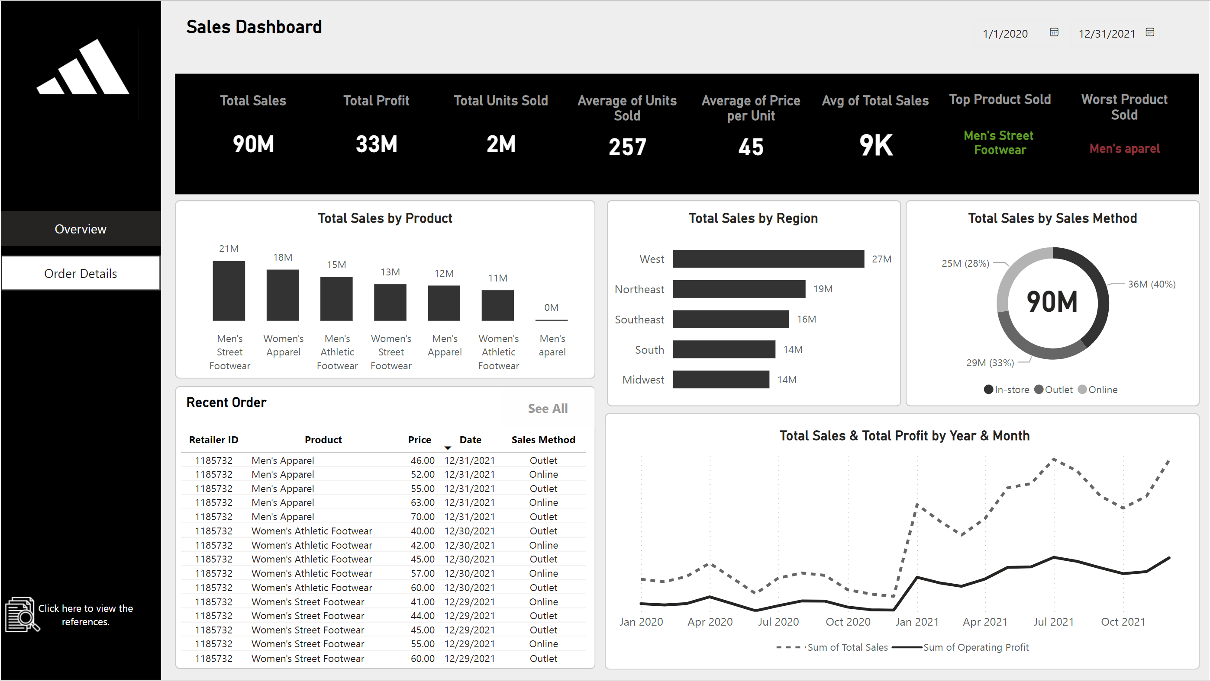
احصائيات الحركة الجوية
Dashboard Screenshot
Click here to interact with the dashboard.
Notes:
image
No alt text provided
textbox
No alt text provided
actionButton
No alt text provided
pageNavigator
No alt text provided
image
No alt text provided
image
No alt text provided
clusteredColumnChart
No alt text provided
اجمالي الحركة الجوية للرحلات في مطارات المملكة
No alt text provided
image
No alt text provided
clusteredColumnChart
No alt text provided
اجمالي الحركة الجوية للركاب في مطارات المملكة
No alt text provided
image
No alt text provided
clusteredColumnChart
No alt text provided
اجمالي الحركة الجوية للشحن في مطارات المملكة
No alt text provided
image
No alt text provided
shape
No alt text provided
image
No alt text provided
card
No alt text provided
card
No alt text provided
shape
No alt text provided
shape
No alt text provided
card
No alt text provided
card
No alt text provided
card
No alt text provided
card
No alt text provided
card
No alt text provided
textbox
No alt text provided
shape
No alt text provided
shape
No alt text provided
shape
No alt text provided
shape
No alt text provided
card
No alt text provided
card
No alt text provided
shape
No alt text provided
shape
No alt text provided
card
No alt text provided
card
No alt text provided
card
No alt text provided
card
No alt text provided
card
No alt text provided
textbox
No alt text provided
shape
No alt text provided
shape
No alt text provided
shape
No alt text provided
shape
No alt text provided
card
No alt text provided
card
No alt text provided
shape
No alt text provided
shape
No alt text provided
card
No alt text provided
card
No alt text provided
card
No alt text provided
card
No alt text provided
card
No alt text provided
textbox
No alt text provided
shape
No alt text provided
shape
No alt text provided
shape
No alt text provided
اسماء المطارات
No alt text provided

Slide 10
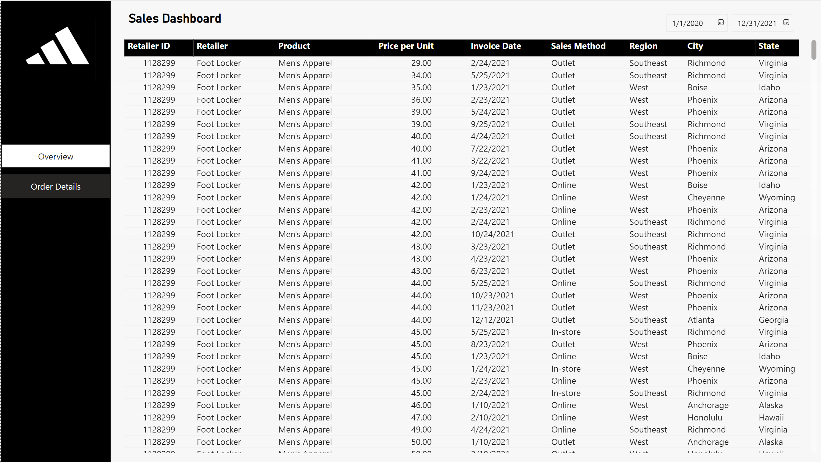
احصائيات الحركة الجوية
Dashboard Screenshot
Click here to interact with the dashboard.
Notes:
image
No alt text provided
textbox
No alt text provided
actionButton
No alt text provided
pageNavigator
No alt text provided
image
No alt text provided
image
No alt text provided
clusteredColumnChart
No alt text provided
اجمالي الحركة الجوية للرحلات في مطارات المملكة
No alt text provided
image
No alt text provided
clusteredColumnChart
No alt text provided
اجمالي الحركة الجوية للركاب في مطارات المملكة
No alt text provided
image
No alt text provided
clusteredColumnChart
No alt text provided
اجمالي الحركة الجوية للشحن في مطارات المملكة
No alt text provided
image
No alt text provided
shape
No alt text provided
image
No alt text provided
card
No alt text provided
card
No alt text provided
shape
No alt text provided
shape
No alt text provided
card
No alt text provided
card
No alt text provided
card
No alt text provided
card
No alt text provided
card
No alt text provided
textbox
No alt text provided
shape
No alt text provided
shape
No alt text provided
shape
No alt text provided
shape
No alt text provided
card
No alt text provided
card
No alt text provided
shape
No alt text provided
shape
No alt text provided
card
No alt text provided
card
No alt text provided
card
No alt text provided
card
No alt text provided
card
No alt text provided
textbox
No alt text provided
shape
No alt text provided
shape
No alt text provided
shape
No alt text provided
shape
No alt text provided
card
No alt text provided
card
No alt text provided
shape
No alt text provided
shape
No alt text provided
card
No alt text provided
card
No alt text provided
card
No alt text provided
card
No alt text provided
card
No alt text provided
textbox
No alt text provided
shape
No alt text provided
shape
No alt text provided
shape
No alt text provided
اسماء المطارات
No alt text provided

Slide 11
03
PWC Calls Center Performance

Slide 12
Dashboard Overview:
A call center dashboard that displays call center metrics and allows managers and teams to monitor and optimize performance.
Here are some questions a dashboard can answer:
Total Calls Received
Total Calls Answered: Number and percentage of calls answered.
Total Calls Unanswered: Number and percentage of calls that were not answered.
Resolved Inquiries: Total number and percentage of inquiries that were successfully resolved.
Unresolved Inquiries: Total number and percentage of inquiries that remain unresolved.
Top 3 Performing Agents: Performance ranking of the top three agents.
Average Customer Satisfaction: Overall satisfaction rating based on customer feedback.

Slide 13
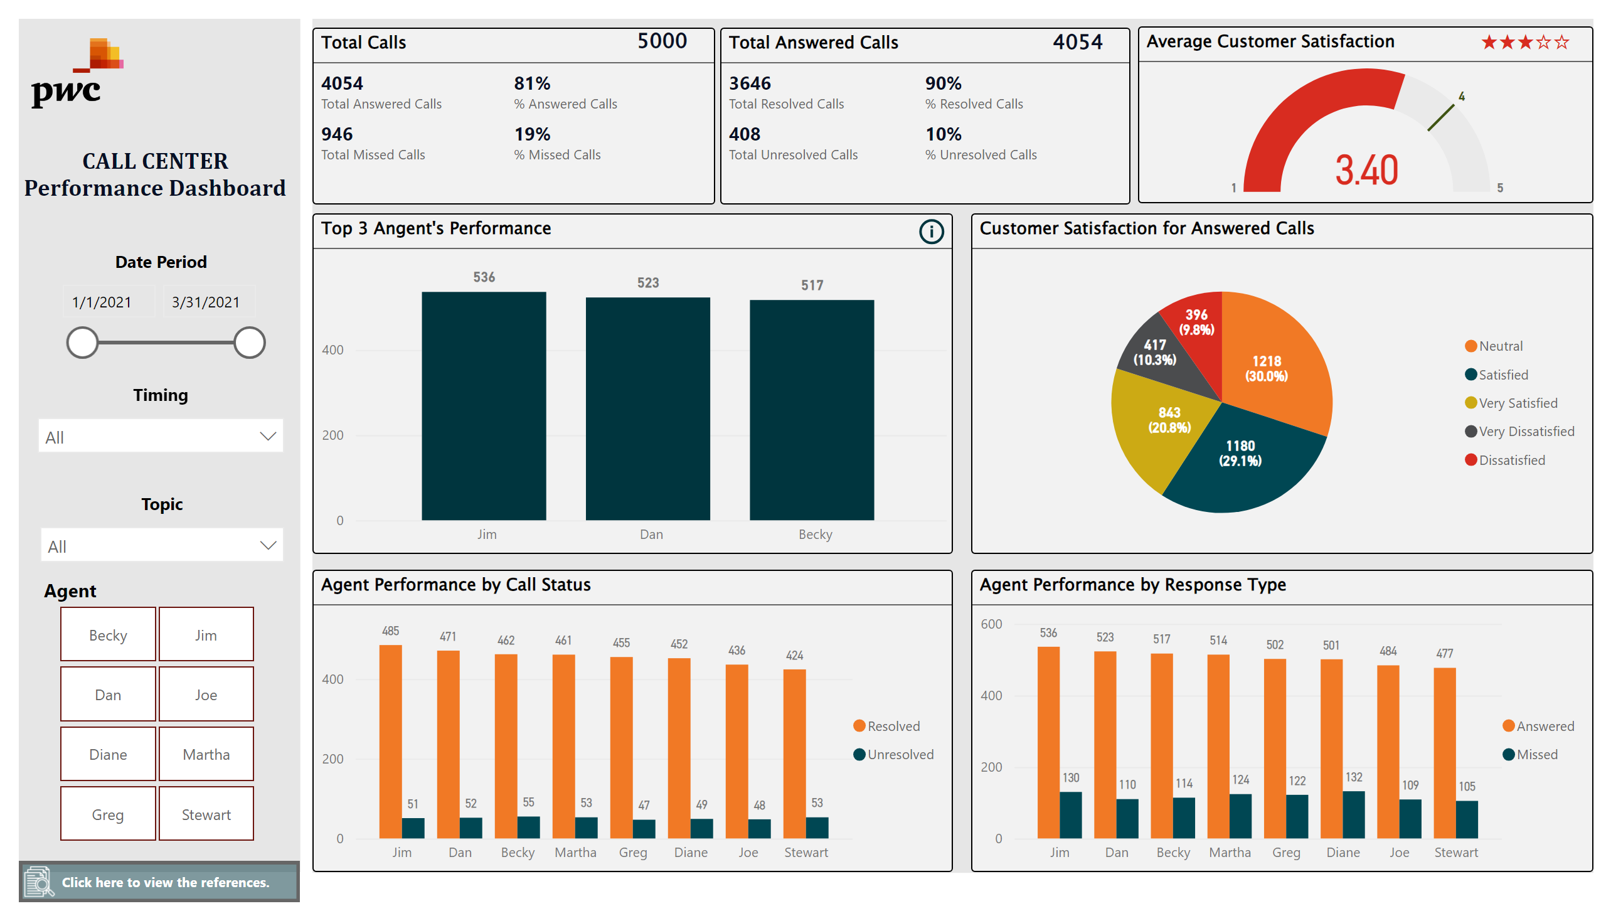
احصائيات الحركة الجوية
Dashboard Screenshot
Click here to interact with the dashboard.
Notes:
image
No alt text provided
textbox
No alt text provided
actionButton
No alt text provided
pageNavigator
No alt text provided
image
No alt text provided
image
No alt text provided
clusteredColumnChart
No alt text provided
اجمالي الحركة الجوية للرحلات في مطارات المملكة
No alt text provided
image
No alt text provided
clusteredColumnChart
No alt text provided
اجمالي الحركة الجوية للركاب في مطارات المملكة
No alt text provided
image
No alt text provided
clusteredColumnChart
No alt text provided
اجمالي الحركة الجوية للشحن في مطارات المملكة
No alt text provided
image
No alt text provided
shape
No alt text provided
image
No alt text provided
card
No alt text provided
card
No alt text provided
shape
No alt text provided
shape
No alt text provided
card
No alt text provided
card
No alt text provided
card
No alt text provided
card
No alt text provided
card
No alt text provided
textbox
No alt text provided
shape
No alt text provided
shape
No alt text provided
shape
No alt text provided
shape
No alt text provided
card
No alt text provided
card
No alt text provided
shape
No alt text provided
shape
No alt text provided
card
No alt text provided
card
No alt text provided
card
No alt text provided
card
No alt text provided
card
No alt text provided
textbox
No alt text provided
shape
No alt text provided
shape
No alt text provided
shape
No alt text provided
shape
No alt text provided
card
No alt text provided
card
No alt text provided
shape
No alt text provided
shape
No alt text provided
card
No alt text provided
card
No alt text provided
card
No alt text provided
card
No alt text provided
card
No alt text provided
textbox
No alt text provided
shape
No alt text provided
shape
No alt text provided
shape
No alt text provided
اسماء المطارات
No alt text provided

Slide 14
04
Incident Management Dashboard

Slide 15
Dashboard Overview:
This dashboard provides a comprehensive view of incident management activities within an organization. It presents key metrics and visualizations to help track incident status, resolution times, and customer satisfaction.
Here are some questions a dashboard can answer:
How many incidents are currently open.
What is the average resolution time for incidents.
Which priority level has the highest number of incidents.
How satisfied are customers with the incident resolution process.
What percentage of incidents are resolved within the target time frame.
What is the most common incident category.

Slide 16
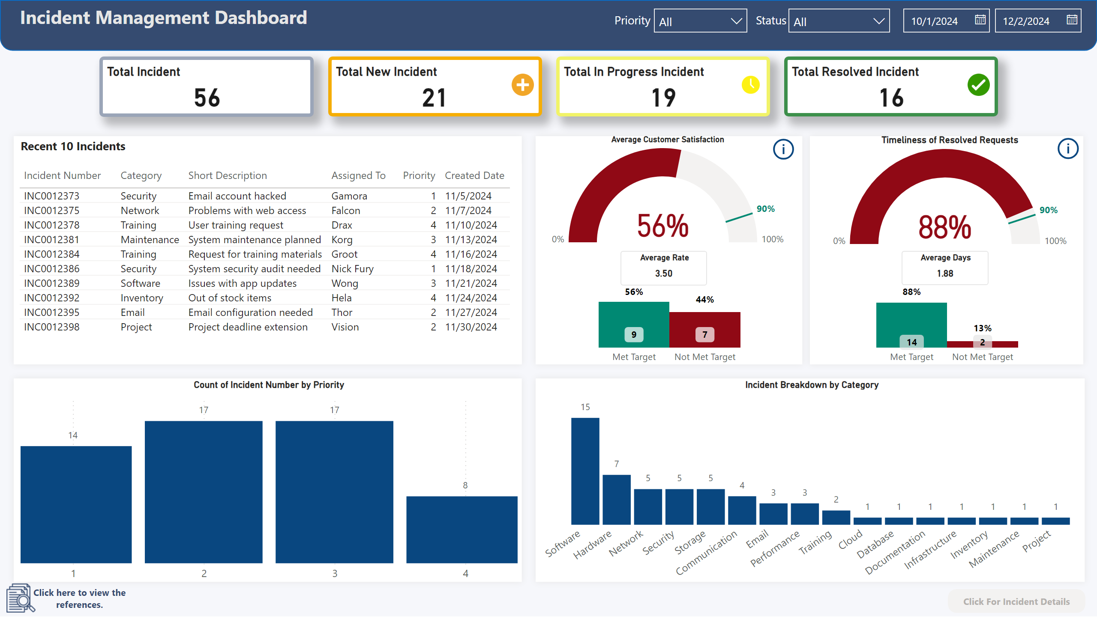
احصائيات الحركة الجوية
Dashboard Screenshot
Click here to interact with the dashboard.
Notes:
image
No alt text provided
textbox
No alt text provided
actionButton
No alt text provided
pageNavigator
No alt text provided
image
No alt text provided
image
No alt text provided
clusteredColumnChart
No alt text provided
اجمالي الحركة الجوية للرحلات في مطارات المملكة
No alt text provided
image
No alt text provided
clusteredColumnChart
No alt text provided
اجمالي الحركة الجوية للركاب في مطارات المملكة
No alt text provided
image
No alt text provided
clusteredColumnChart
No alt text provided
اجمالي الحركة الجوية للشحن في مطارات المملكة
No alt text provided
image
No alt text provided
shape
No alt text provided
image
No alt text provided
card
No alt text provided
card
No alt text provided
shape
No alt text provided
shape
No alt text provided
card
No alt text provided
card
No alt text provided
card
No alt text provided
card
No alt text provided
card
No alt text provided
textbox
No alt text provided
shape
No alt text provided
shape
No alt text provided
shape
No alt text provided
shape
No alt text provided
card
No alt text provided
card
No alt text provided
shape
No alt text provided
shape
No alt text provided
card
No alt text provided
card
No alt text provided
card
No alt text provided
card
No alt text provided
card
No alt text provided
textbox
No alt text provided
shape
No alt text provided
shape
No alt text provided
shape
No alt text provided
shape
No alt text provided
card
No alt text provided
card
No alt text provided
shape
No alt text provided
shape
No alt text provided
card
No alt text provided
card
No alt text provided
card
No alt text provided
card
No alt text provided
card
No alt text provided
textbox
No alt text provided
shape
No alt text provided
shape
No alt text provided
shape
No alt text provided
اسماء المطارات
No alt text provided

